Slide 1
Cost estimation

Slide 2
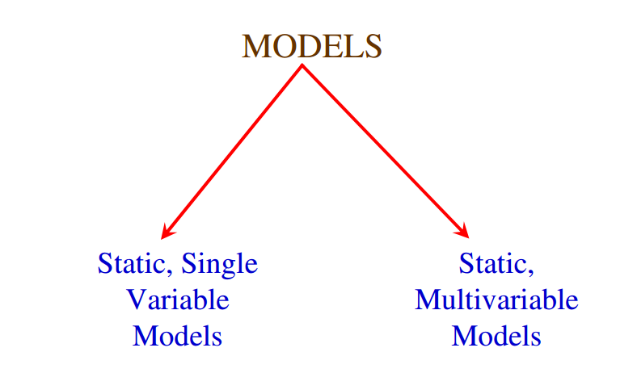

Slide 3
Static, Single Variable Models
use an equation to estimate the desired values such as cost, time, effort, etc.
all depend on the same variable used as predictor (say, size).
An example of the most common equations is:
C = a L ^{b} (i)
C is the cost, L is the size and a,b are constants

Slide 4
SEL
Software Engineering Laboratory of the university of Maryland established SEL model.
E = 1.4 L^{0.93}
D = 4.6 L^{0.26}
Effort (E in Person-months), duration (D, in months) are calculated from the number of lines of code (L, in thousands of lines) used as a predictor.

Slide 5
Static, Multivariable Models(Walston-Felix model )
These models are often based on equation (i)
they actually depend on several variables representing various aspects of the software development environment, for example method used, user participation, customer oriented changes, memory constraints, etc.
E = 5.3 L ^{0.91}
D = 4.1 L ^{0.36}

Slide 6
Example
Compare the Walston-Felix model with the SEL model on a software development expected to involve 8 person-years of effort.
Software Project Planning (a) Calculate the number of lines of source code that can be produced. (b)Calculate the duration of the development. (c)Calculate the productivity in LOC/PY (d)Calculate the average manning

Slide 7
Solution
The amount of manpower involved = 8 PY = 96 person-months (a) Number of lines of source code can be obtained by reversing equation to give:
L = (E/a)^{1/b}
L(SEL) = (96/1.4)^{1/0.93} = 94264 LOC L(W-F) = (96/5.2)^{1/0.91} = 24632 LOC.

Slide 8
(b) Duration in months can be calculated by means of equation
D(SEL) = 4.6 (L)^{0.26} = 4.6 (94.264)^{0.26} = 15 months
D(W-F) = 4.1 L^{0.36} = 4.1(24.632)^{0.36} = 13 months

Slide 9
(c) Productivity is the lines of code produced per person/month (year)
P (SEL) = 94264 /8 = 11783 LOC / Person−Years
P (W − F) =24632/8= 3079 LOC / Person −Years

Slide 10
(d) Average manning is the average number of persons required per month in the project.
M(SEL) = 96 P-M/15M = 6.4 persons
M(W-F) = 96 P-M/13M = 7.4 persons

Slide 11
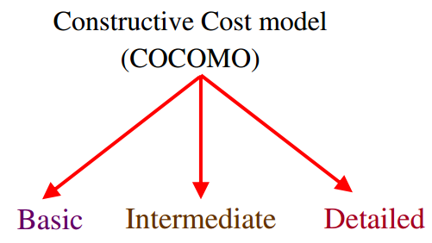
COCOMO(COnstructive COst MOdel)

Slide 12
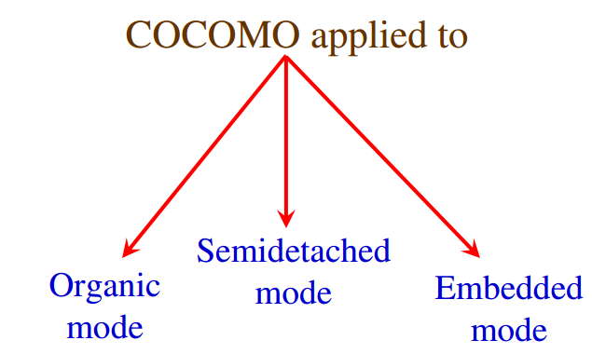
COCOMO

Slide 13
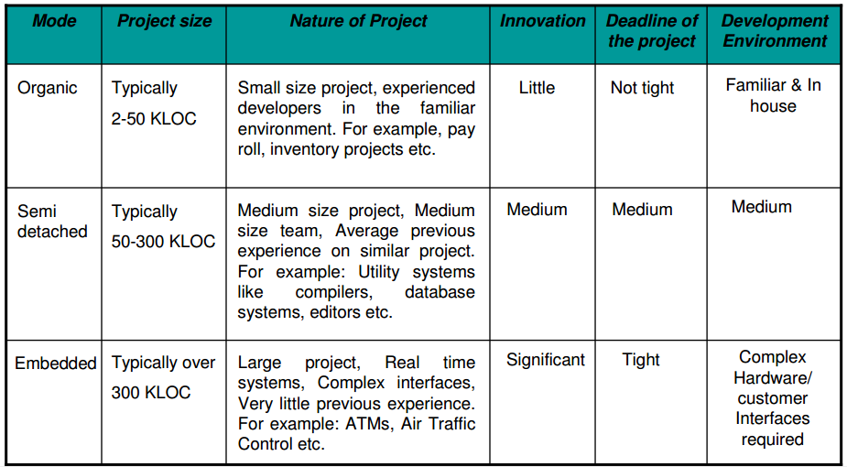

Slide 14
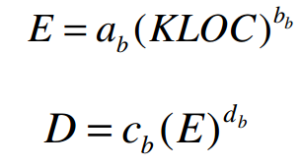
Basic
Basic COCOMO model takes
The coefficients a^{b}, b^{b}, c^{b} and d^{b} are given in table

Slide 15
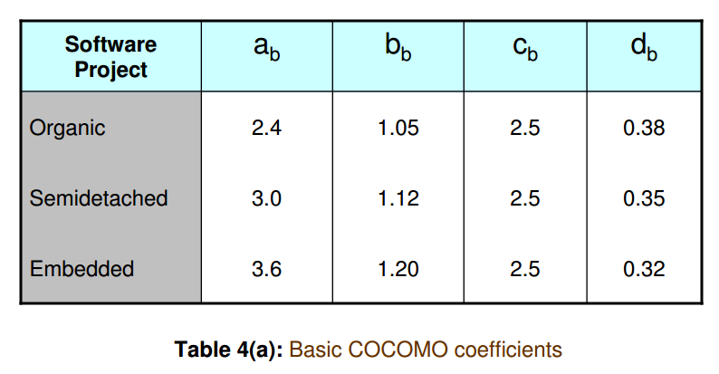
Coefficients Table

Slide 16
Staff required ?
Productivity ?

Slide 17


When effort and development time are known, the average staff size to complete the project may be calculated as:
When project size is known, the productivity level may be calculated as:

Slide 18
Example
Suppose that a project was estimated to be 400 KLOC. Calculate the effort and development time for each of the three modes i.e., organic, semidetached and embedded.

Slide 19
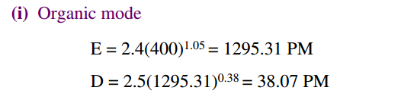
Solution

Slide 20
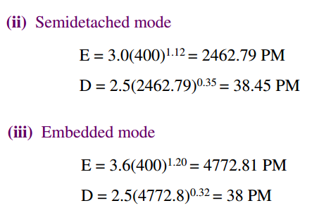
Solution

Slide 21
Example
A project size of 200 KLOC is to be developed. Software development team has average experience on similar type of projects. The project schedule is not very tight. Calculate the effort, development time, average staff size and productivity of the project.

Slide 22
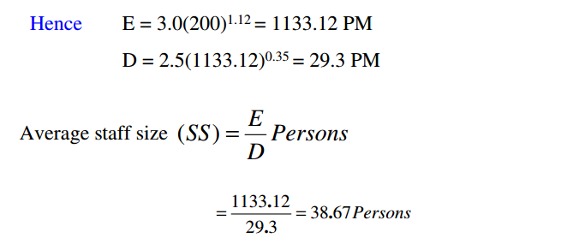
The semi-detached mode is the most appropriate mode; keeping in view the size, schedule and experience of the development team.

Slide 23
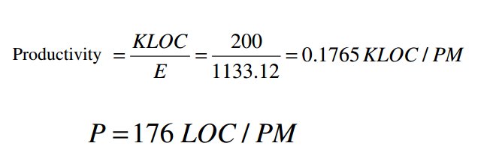

Slide 24
Intermediate Model
Boehm introduced an additional set of 15 predictors called cost drivers in the intermediate model to take account of software development environment.
Cost drivers are used to adjust the nominal cost of a project to the actual project environment hence increasing the accuracy of the estimates.

Slide 25
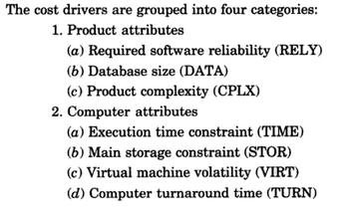
Cost Drivers

Slide 26
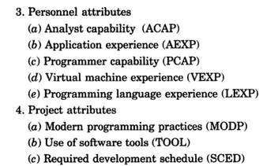
Cost Drivers
Notes:
group1 : Low programming language experience () and low application experience () but high programming capability()
group 2: very high analyst capability() and nominal application experience() but low programming language experience()
group 3: low programming language experience () and nominal analyst capability () but very high programming capability().

Slide 27
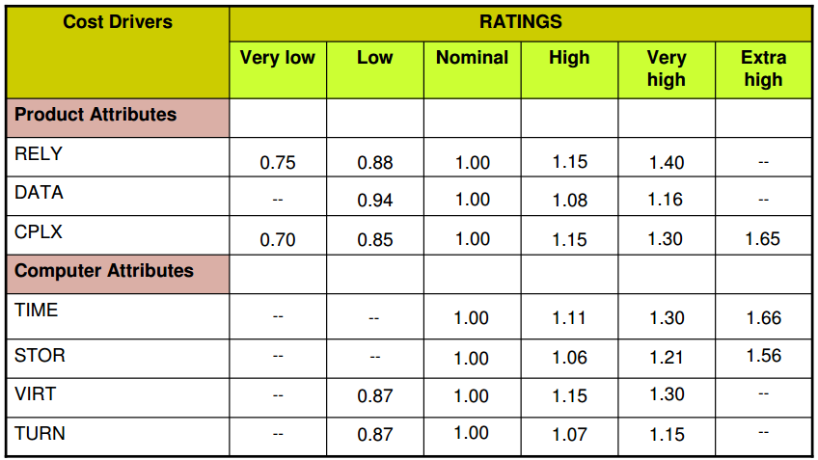
Rating
Notes:
group1 : Low programming language experience () and application experience () but high programming capability()
group 2: very high analyst capability() and nominal application experience() but low programming language experience()
group 3: low programming language experience () and nominal analyst capability () but very high programming capability().

Slide 28
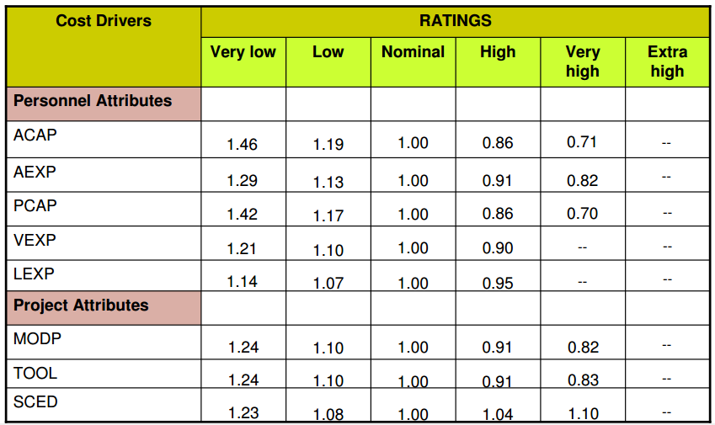
Rating
Notes:
group1 : Low programming language experience (1.07) and low application experience (1.13) but high programming capability(0.86)
group 2: very high analyst capability(0.71) and nominal application experience(1.00) but low programming language experience(1.07)
group 3: low programming language experience (1.07) and nominal analyst capability (1.00) but very high programming capability(0.70).

Slide 29
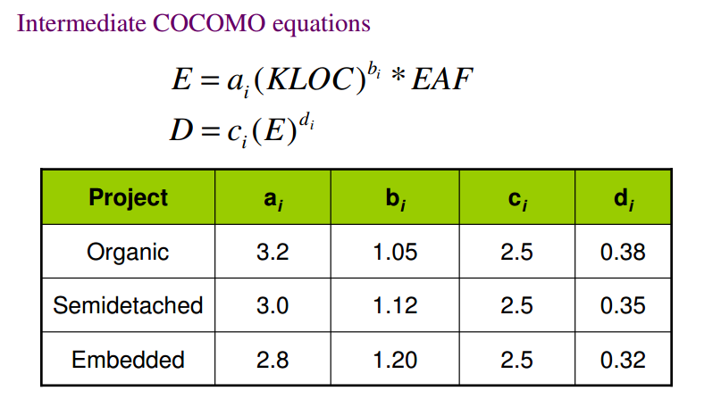
Formula
EAF (Effort Adjustment Factor):- The multiplying factors for all 15 factors are multiplied to get EAF.

Slide 30
Example
“Mr. Harish is an owner of automobile company and need to develop a software for payroll system for his staff having very large number of employees. So he give contract to XYZ company. Company say that the project will need very large database. Now company conduct interview for selecting a team for developing a project.”
Gp1:- Developers with low programming capabilities but high programming language experience.
Gp2 :- Developers with high analyst capabilities and high programming capabilities but low programming language experience.
Gp3 :- Developers with low virtual machine experience, low programming capabilities but very high application experience.
Gp4 :- Developers with high virtual machine experience, high programming capabilities but very low programming language experience.
Which group company will prefer ?

Slide 31
Example
A new project with estimated 400 KLOC embedded system has to be developed. Project manager has a choice of hiring from two pools of developers: Very highly capable with very little experience in the programming language being used.
Or Developers of low quality but a lot of experience with
the programming language. What is the impact of
hiring all developers from one or the other pool ?

Slide 32
Solution
This is the case of embedded mode and model is intermediate COCOMO
E = _{ai} (KLOC)^{bi}

